Slide 1
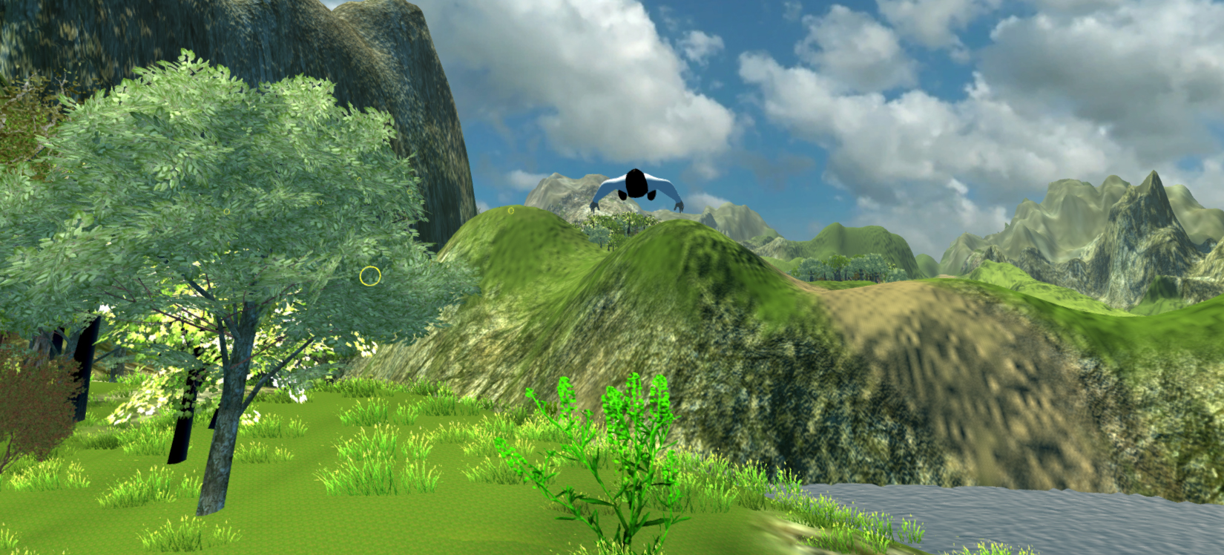
Rift Wingsuit
Sebastian Nickel, Jonas Kleinkauf, Andreas Dietze, Manuel Schmitt, Sascha Ibach

Slide 2
Content
Summary
Project presentation (pp)
Project extension
Responsibilities
Milestones
Risks

Slide 3
Summary
Rift Wingsuit offers a realistic world from the perspective of wingsuit sport. Experience the feeling of total freedom, using the Oculus Rift head-mounted display in combination with guesture control for the protagonist.
Wingsuit valley awaits you !

Slide 4
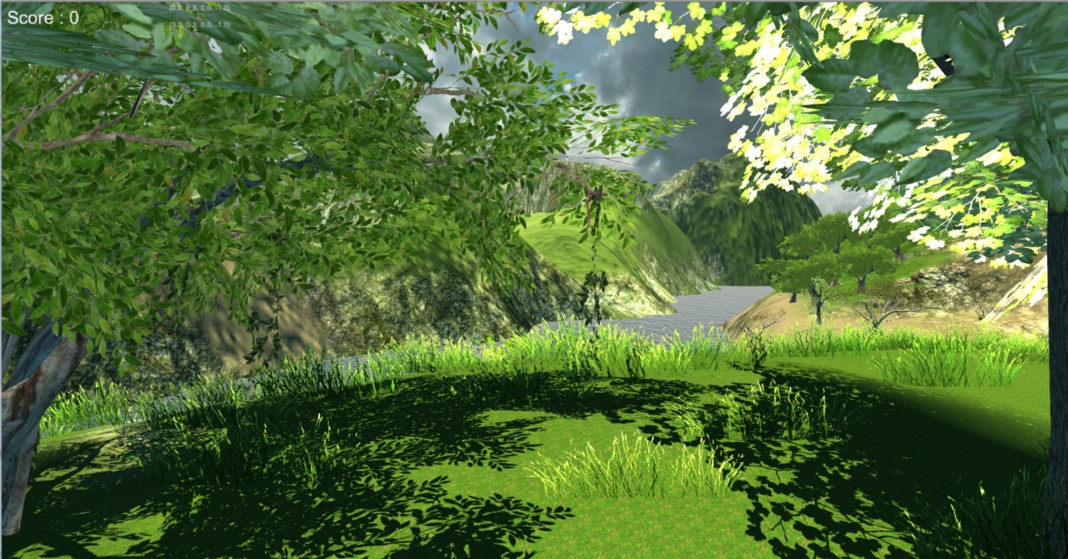
pp - World
Developed with Unity 3D
Deployed assets
Own part
Scripts
Vegetation
Water
Ambiance

Slide 5
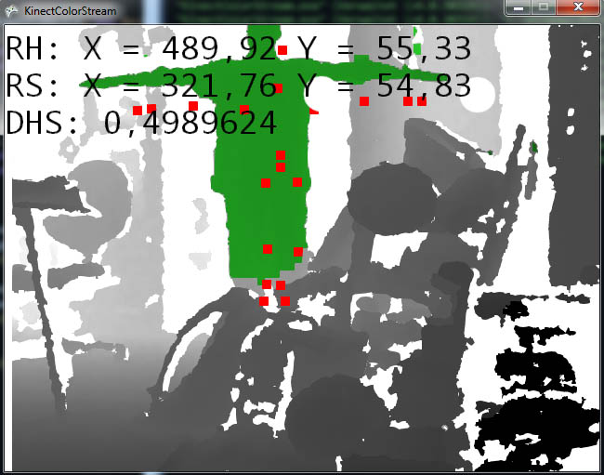
pp – Kinect control
Player control by arm tracking(Kinect):
X-Axis (Pitch)
Forward / Back
Y-Axis(Yaw)
Up / Down
Right-Arm-Tracking
Notes:
Rotation-Lock-X => Es kann nicht übersteuert werden

Slide 6
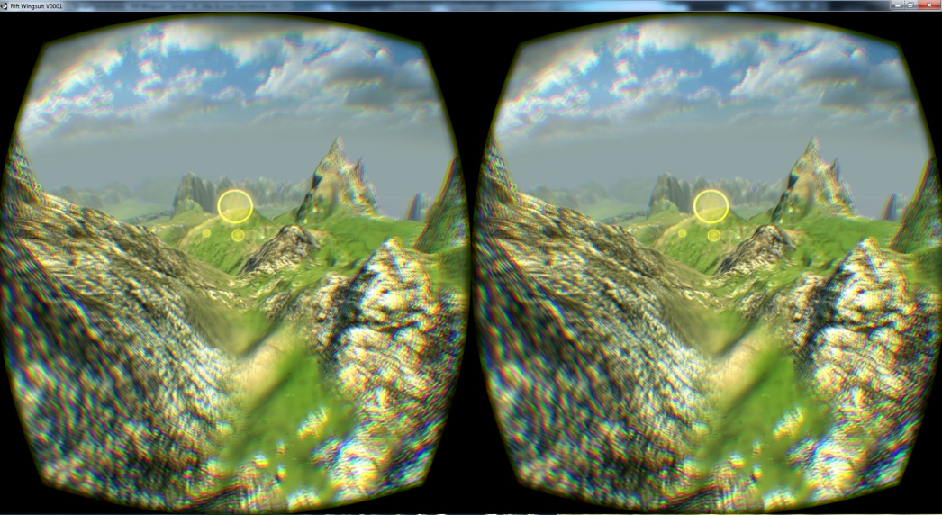
pp - Oculus Rift support
Using head rotation for first-person-view
To make the game more immversive

Slide 7
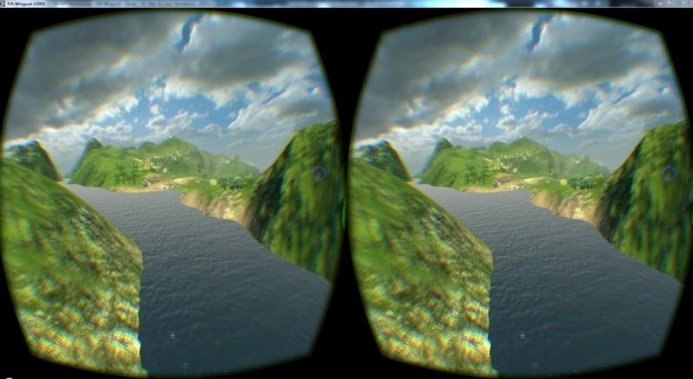
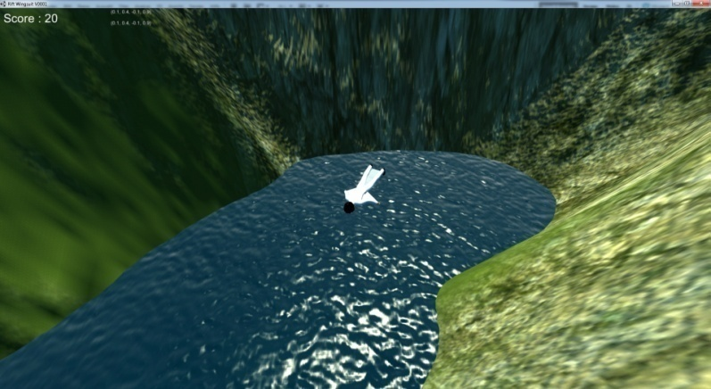
pp - Server and client
Only used as a spectator client
Used for demonstrational purposes
Used to get a better view of the player´s perspective (FPV-Transmission)

Slide 8
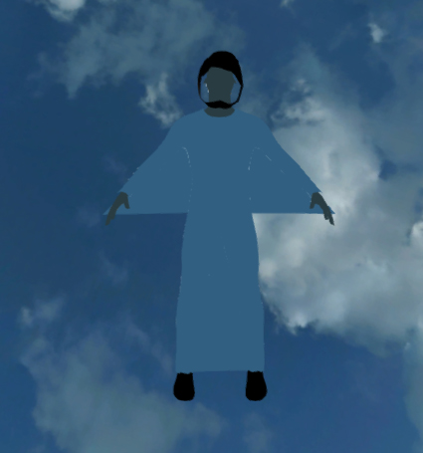
Project extensions
Fly physics
Player model (visible arm movement)
Effect-Events (flying through a bridge)
Rework and/or improve kinect control
Graphical update
Post-effects (radial blur)
Some terrain and world improvements
Clouds
Better lighting

Slide 9
Project extensions
Client improvment
Additional camera styles
Some fly-by-camera styles
Improve existing camera styles
Menues and simplified handling
Game flow (menues and gesture control – maybe makey makey)
Improved construction concept
Location of kinect, player, spectators, etc.
Simplified handling of the game and it´s features
Documentation
Frameworks, Packages
User Guide (how to get it running)
Goal: suitable for HS-LAN and Open-Lab (HS-Informationstage)

Slide 10
Responsibilities (Assistent)
Oculus DK2 / Vive
Sascha Ibach (A. Dietze)
Kinect V1/V2
Andreas Dietze (S. Nickel)
Flyphysics
Sebastian Nickel (A. Dietze)
Player model
Jonas Kleinkauf (S. Ibach)
World and ambiance
Jonas Kleinkauf (M. Schmitt)
Post processing
Manuel Schmitt (J.K., S.N.)
Audio
Jonas Kleinkauf (A. Dietze)
Menues
Manuel Schmitt (S.N., S.I.)
Gamelogics
Jonas Kleinkauf (Comp. Grp.)
Documentation and User Guide
Andreas Dietze (M.S., S.I.)
Simplified handling
Sascha Ibach (A. Dietze)

Slide 11
Milestone 1
Week | Andreas Dietze
05.12 – 05.19 | Project clean up and initial git uplaod Compatibility test with Kinect V2 (min win 8 :/ ) Setup to old working state with client
05.19 – 05.26 | Setup project (interaction laboratory) for 09.06 Location and setup improvement Check out new world assets
05.26 – 06.02 | Setup project (interaction laboratory) for 09.06 Vive integration, Vive project functionality (visual)

Slide 12
Milestone 1
Week | Jonas Kleinkauf
05.12 – 05.19 | Unity Terrain Optimizations, Terrain Generation Tests?
05.19 – 05.26 | Obstacle Programming: Action Collision, Bonus Items, Updrafts
05.26 – 06.02 | New Level Creation using Terrain Generators

Slide 13
Milestone 1
Week | Manuel Schmitt
05.12 – 05.19 | Working into the project and Unity Engine
05.19 – 05.26 | Creation of post-processing effects like bloom and blur
05.26 – 06.02 | Creation of ambient-occlusion-light -map

Slide 14
Milestone 1
Week | Sebastian Nickel
05.12 – 05.19 | Raw comprehension of the laws of aerodynamics
05.19 – 05.26 | Prototyping first aerodynamic model for the game
05.26 – 06.02 | Continue to work on prototype

Slide 15
Milestone 1
Week | Sascha Ibach
05.12 – 05.19 | Working into the project and Unity Engine
05.19 – 05.26 | Working into Oculus and possible improvements
05.26 – 06.02 | Oculus improvements (Menu, …)

Slide 16
Milestone 2
Week | Andreas Dietze
06.02 – 06.09 | Vive project functionality (haptic and gesture tests) Kinect improvement Balancing the new developed features
06.09 – 06.16 | Vive location and setup improvement Fly physics Documentation
06.16 – 06.23 | Fly physics Documentation User Guide

Slide 17
Milestone 2
Week | Jonas Kleinkauf
06.02 – 06.09 | Level Design + Programming, Obstacle Placement, Player Path
06.09 – 06.16 | Make the Game more interesting to Play: Secrets, Collectibles, World Refinement
06.16 – 06.23 | Player Model refinement, Rigging, Texturing

Slide 18
Milestone 2
Week | Manuel Schmitt
06.02 – 06.09 | Buffer for ambient-occlusion Alternative: Implementation of light effects like god-rays or atmospheric scattering
06.09 – 06.16 | Implementation of client-menu-structure
06.16 – 06.23 | Implementation of spectator-client-menu

Slide 19
Milestone 2
Week | Sebastian Nickel
06.02 – 06.09 | Increase flexibility of established fly-physics prototype Error tolerence, …
06.09 – 06.16 | Add configuratable properties to flying-model for an even more realistic experience Actual height of player, weight, …
06.16 – 06.23 | Thorough testing of the flying physics

Slide 20
Milestone 2
Week | Sascha Ibach
06.02 – 06.09 | Menus (Controls, Oculus (Shader))
06.09 – 06.16 | Game Interaction / - Logic / -Flow (Parachute landing, …)
06.16 – 06.23 | Buffer for GameLogic Playermodel

Slide 21
Exams
16.07.2016 - 30.07.2016 and 12.09.2016 - 24.09.2016
Exam and preperation 23.06 - 30.07
Sec. exam phase -> individual schedule

Slide 22
Milestone 3
Week | Andreas Dietze
08.01 – 08.08 | Fly physics User Guide
08.08 – 08.16 (less time) | Client cam views Client audio Client handling improvement
08.16 – 24.08 | Client improvement buffer
08.24 – 09.14 | Buffer until project end (Fly physics, game logics, assistant)

Slide 23
Milestone 3
Week | Jonas Kleinkauf
08.01 – 08.08 | Player Model Animations, Integrating Animations with User Input
08.08 – 08.16 | Integration of new World + Game objects other works of the project team
08.16 – 24.08 | Producing Background Music and Sound Effects
08.24 – 09.14 | Buffer until project end (Fly physics, game logics, assistant)

Slide 24
Milestone 3
Week | Manuel Schmitt
08.01 – 08.08 | Creation of a users guide for the project
08.08 – 08.16 | Creation of a project documentation
08.16 – 24.08 | Buffer for any relevant work
08.24 – 09.14 | Buffer for any relevant work

Slide 25
Milestone 3
Week | Sebastian Nickel
08.01 – 08.08 | Evaluation of “Freenect2”, an open-source KinectV2 driver
08.08 – 08.16 | Assisting with the menu structure-related work e.g.: possible improvements, testing, …
08.16 – 24.08 | Buffer for related work; Overall testing („Bug hunting“)
08.24 – 09.14 | Buffer until project end (Fly physics, game logics, assistant)

Slide 26
Milestone 3
Week | Sascha Ibach
08.01 – 08.08 | Creation of a users guide for the project (Client)
08.08 – 08.16 | Creation of a project documentation (Client)
08.16 – 24.08 | Buffer for related work
08.24 – 09.14 | Buffer for related work

Slide 27
Risks
Fly physics - math too complex/complicated
Arm network transmission
Post-effects too performance- consuming (scattering, ambient occlusion)
Realtime Performance Issues for slower PCs (Graphics Settings?)
AR Performance Problems
Menue handling (Oculus)
Gesture control problems (APIs for Vive not tested yet, currently unstable APIs for Kinect?)
Suitable for HS-Lan and Open-Lab
Ofc: Illness of Project Members (workload balancing)

Slide 28
Github Version Control
Old project source
https://github.com/andreasdietze/Rift-Wingsuit.git
New project source
https://github.com/andreasdietze/Rift-WingsuitV2.git

Slide 29
Thanks for your attention ☺

